Slide 1
Anime EDA & ML Classification
Joel Gn

Slide 2

Overview
Introduction
Industry Growth
Overseas Sales Revenue
Media Mix
Target Markets & Problem Statement
Dataset
Features
Exploratory Data Analysis
Content Complexity
Content Warnings
Titles
Machine Learning Techniques & Results
Decision Trees
Random Forests
One vs Rest with Linear SVC
Conclusion

Slide 3

Introduction
An animated film/television programme/computer game narrative that is either produced in Japan or displays distinctively Japanese aesthetic sensibilities.
Intimately connected to other cultural products, such as comics (manga), and video games.
Rapid growth in the industry after WWII, when Japanese animators combined Western techniques with their own traditions (e.g. kamishibai/ ‘paper play’).
Notable anime studios: TOEI & Studio Ghibli
Anime has enjoyed popular reception outside Japan.

Slide 4
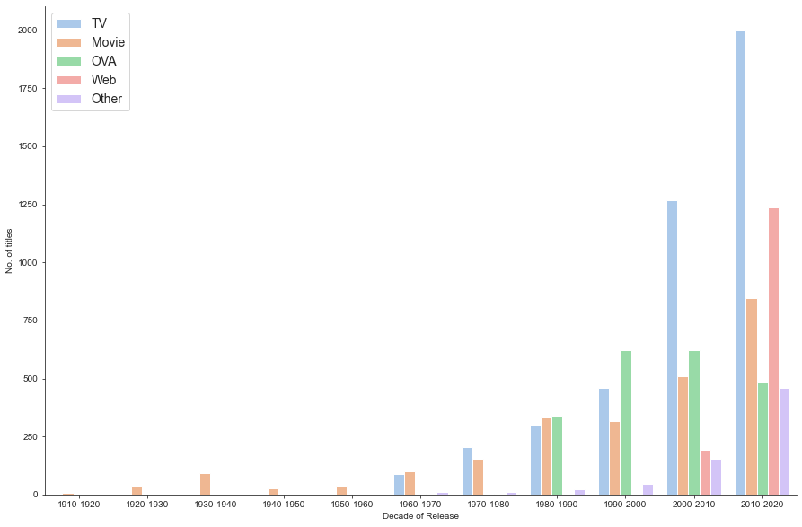
Industry Growth
Source: Anime Planet

Slide 5
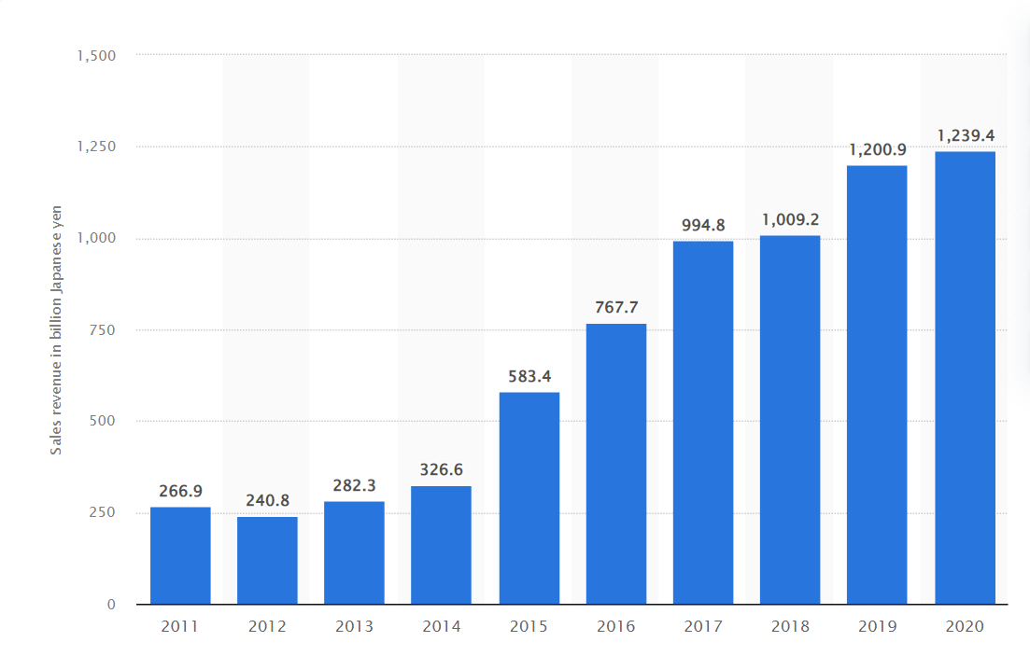
Overseas Sales Revenue
Key overseas markets include US, Canada, China, Taiwan and Hong Kong. Singapore is among the top 20 consumers, based on distribution licenses acquired.
Sources: Statista and Anime Industry Report 2021

Slide 6






Media Mix
Content IP
Apparel
Publishing
Consumables
Games/Applications
Toys/electronics/stationery
Films/Animation

Slide 7

Target Market & Problem Statement
Shounen (少年): Young boys aged 12-18
Shoujo (少女): Young girls aged 12-18
Seinen (青年): Young adult men aged 18 and above
Josei (女性): Young women aged 18 and above
Classification was originally applied to manga, but equally relevant for anime given the proliferation of adaptations over the decades.
While genres do overlap, each category has a few unique characteristics, in terms of narrative and visuals.
Female consumers tend have more differentiated preferences(i.e. watch titles in all categories), compared to their male counterparts.
This classification is often overlooked in non-Japanese recommendation engines.
Objective: To develop a classification algorithm for anime based on these 4 demographics.

Slide 8
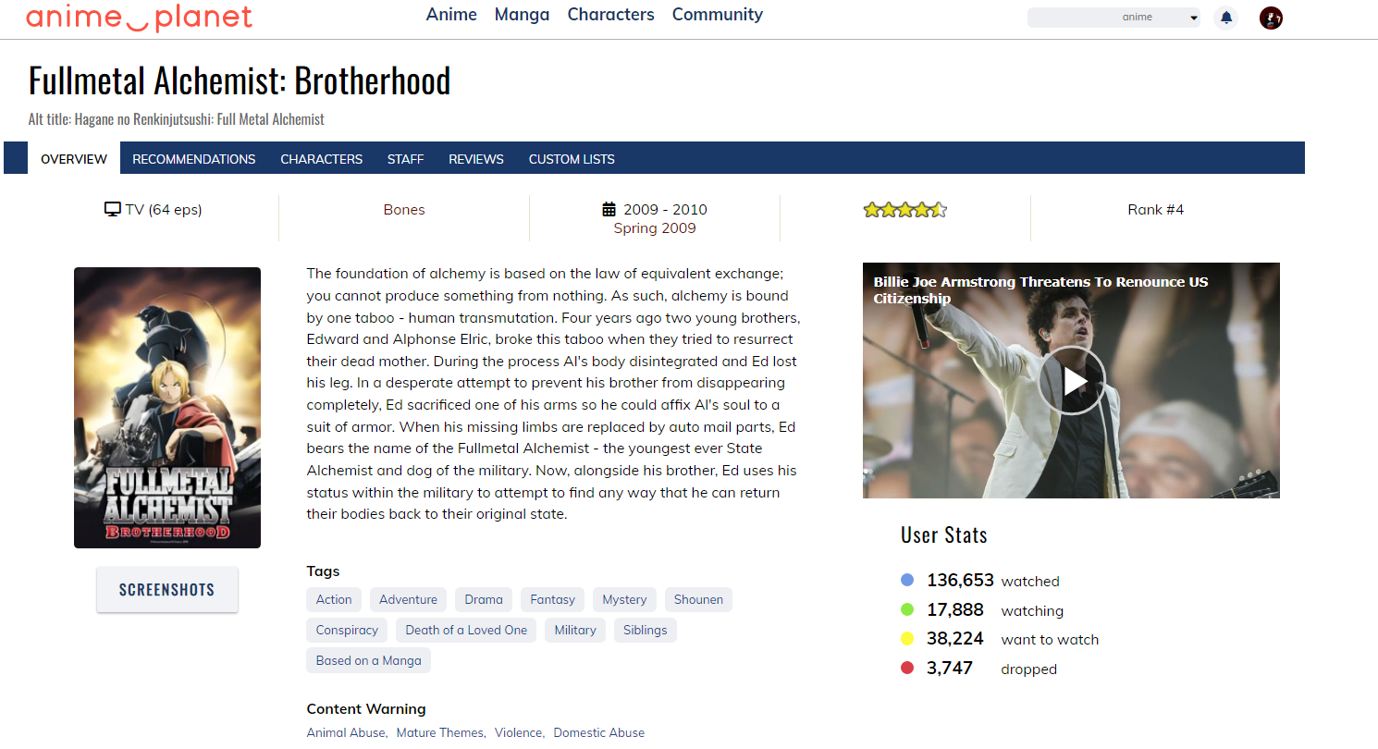
Dataset
14,578 titles scrapped from Anime Planet website.
Source: Anime Dataset | Kaggle (uploaded on 15 June 2020)

Slide 9
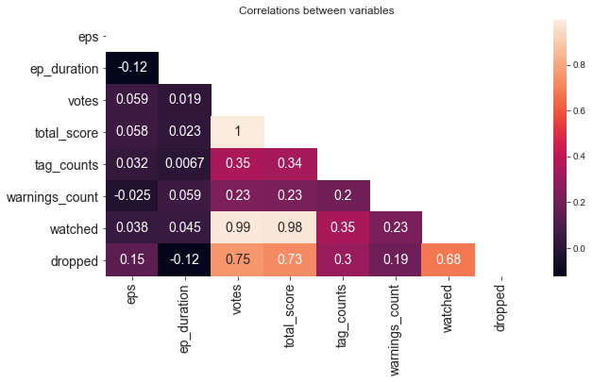
Features

Slide 10
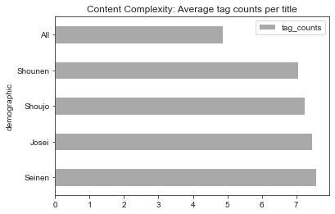
EDA – Content Complexity

Slide 11
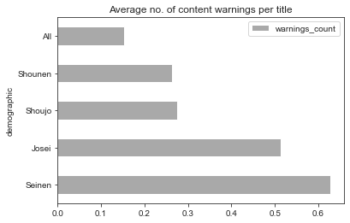
EDA – Content Warnings

Slide 12
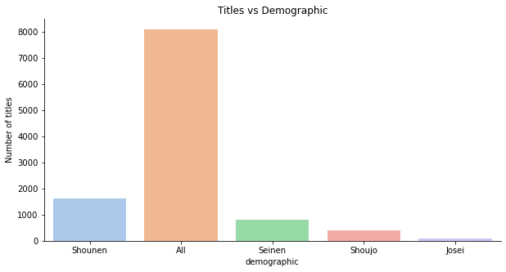
EDA - Titles
0.572
Multi-class problem with highly imbalanced data.
Most titles were either classified as ‘ALL’ (suitable for all groups) or ‘Shounen’.
Hyperparameter turning would be necessary for machine learning (e.g. imblearn.over_sampling).
Baseline Accuracy: 0.572

Slide 13
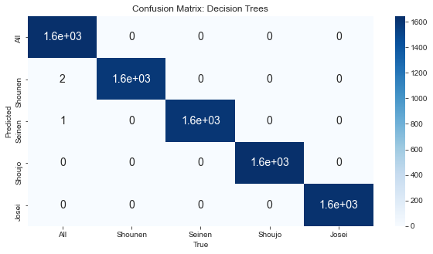
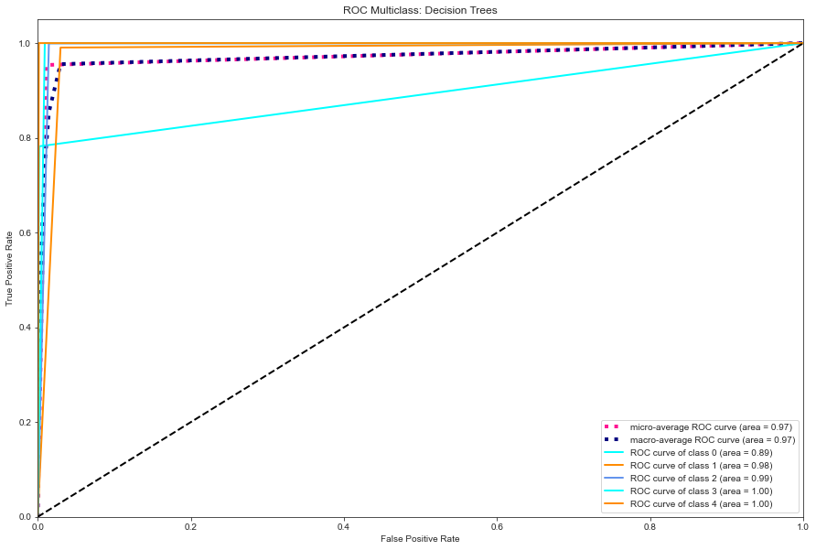
ML Techniques & Results: Decision Trees
Data | Accuracy - CV | Recall – Micro Avg | F1 – Micro Avg
Training | 0.9478 | 1.00 | 1.00
Test | 0.8362 | 1.00 | 1.00

Slide 14
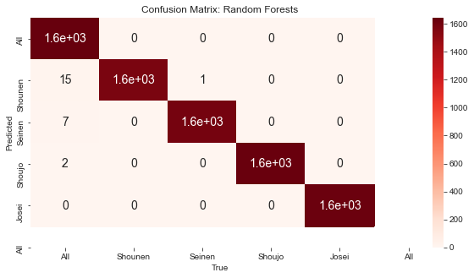
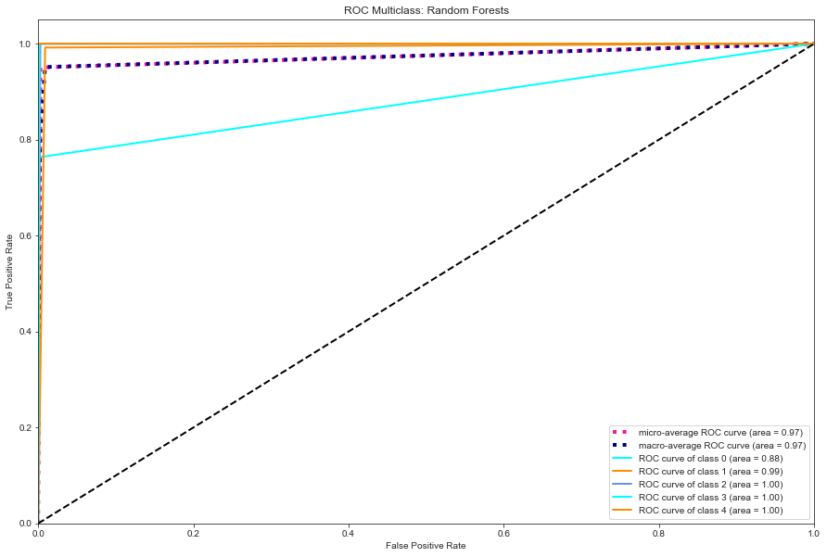
ML Techniques & Results – Random Forests
Data | Accuracy - CV | Recall – Micro Avg | F1 – Micro Avg
Training | 0.9364 | 1.00 | 1.00
Test | 0.7955 | 1.00 | 1.00

Slide 15
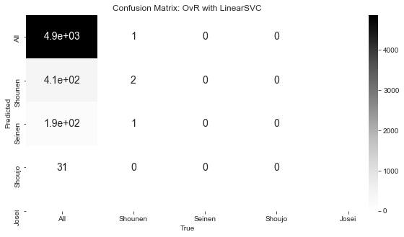
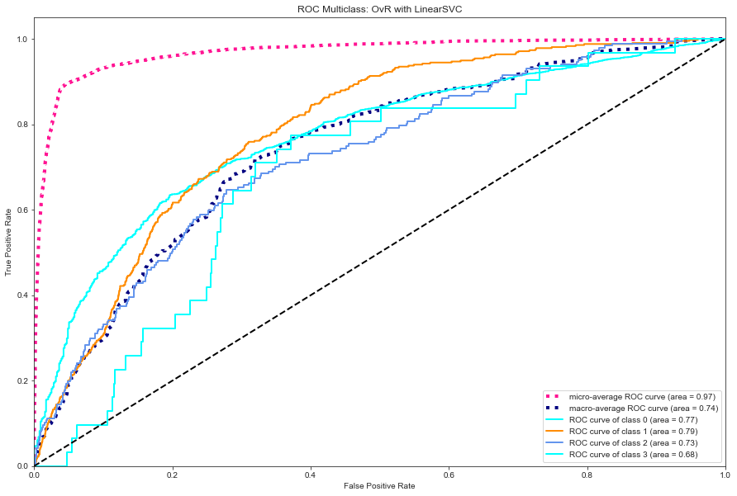
ML Techniques & Results: OvR(LinearSVC)
Data | Accuracy - CV | Recall – Micro Avg | F1 – Micro Avg
Training | 0.8844 | 0.88 | 0.88
Test | 0.8837 | 0.88 | 0.88

Slide 16
Conclusion
Over-representation of shounen works is an inherent characteristic of the market, not a bug.
Further hyperparameter tuning (e.g. balancing weights of classes) would be required for improved accuracy.
Decision Trees and Random Forests return high accuracy, but fare well for AUC ROC, after over-sampling is applied prior to training.
OvR with Linear SVC is much less accurate. Model’s performance is only satisfactory at a threshold range of 0.75-0.79 for all classes in dataset.
Relative to conventional genre/user-based recommendation engines, demographic classification is a more streamlined approach as demographic categories possess unique stylistic characteristics.
Differences in content complexity between categories have also been relatively stable over time in the industry.
A possible strategy for distributors and streaming platforms would be to promote a handful of highly popular mainstream/shounen titles, while enlarging the repository of seinen/shoujo/josei works.

